Slide 1
jQuery Plugins
Expanding the functionality of jQuery
HTML, CSS and JavaScript
Telerik School Academy
http://academy.telerik.com

Slide 2
Table of Contents
jQuery Plugins
jQueryUI
Creating Custom Plugins
Implementing chaining
Plugins Options

Slide 3
jQuery Plugins

Slide 4
jQuery Plugin
A Plugin is just a method that extends the jQuery objects prototype
Enabling all jQuery objects to use this method
Once a plugin is imported, it is used as regular jQuery method
Like addClass(), fadeout() and hide()

Slide 5
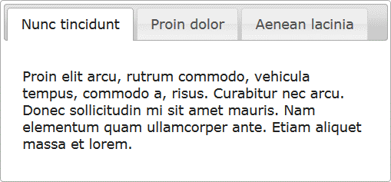
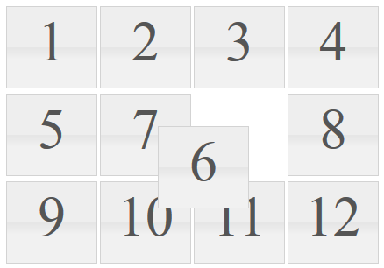
jQuery Plugins
jQuery has many ready-to-use plugins
A library jQueryUI for UI controls
Plugins for UI
Tabs
Arrangeable elements
$("#tabs-holder").tabs();
$("#grid" ).sortable();

Slide 6
jQuery Plugins
Live Demo

Slide 7
Creating Custom jQuery Plugins

Slide 8
Creating jQuery Plugins
jQuery has an easy way to extend the initial functionality with plugins
Just create a regular JavaScript method and attach it to jQuery.fn object
(function($){
$.fn.zoom = function(){
var $this = $(this);
$this.on("mouseover", function() {
//zoom in element
});
$this.on("mouseout", function() {
//zoom out element
});
}
}(jQuery));
$(".image").zoom();

Slide 9
Zoom Plugin
Live Demo

Slide 10
Chaining in Plugins
Chaining is pretty good and useful feature
Better to be implemented in our plugins
Done easy, just return this at the end of the plugin function
(function($){
$.fn.zoom = function(){
var $this = $(this);
$this.on('mouseover', function() {…});
$this.on('mouseout', function() {…});
return $this;
}
}(jQuery));
$('.image')
.zoom()
.addClass('zoom');

Slide 11
Chaining in Plugins
Live Demo

Slide 12
Plugins with Options
Creating plugins more customizable

Slide 13
Plugins with Options
Plugins can also be provided with options
Just pass regular function parameters
(function($){
//zoom with size percents
$.fn.zoom = function(size){
var $this = $(this);
$this.on('mouseover', function() {…});
$this.on('mouseout', function() {…});
return $this;
}
}(jQuery));

Slide 14
Plugins with Options
Live Demo

Slide 15
Plugins Options
Yet the options sometimes become too many
When too many arguments, just use a options object
Give the options as a JSON-like object

Slide 16
Plugins with Options Object
Live Demo

Slide 17
jQuery Plugins

Slide 18
Homework
Create a jQuery plugin for creating dropdown list
By given the following:
<select id="dropdown">
<option value="1">One</option>
<option value="2">Two</option>
</select>
$('#dropdown').dropdown()
Produces the following HTML:
<select id="dropdown" style="display: none">…</select>
<div class="dropdown-list-container">
<ul class="dropdown-list-options">
<li class="dropdown-list-option" data-value="0">One</li>
…
</ul>
</div>
And make it work as SELECT node
Selecting an one of the generated LI nodes, selects the corresponding OPTION node
So $('#dropdown:selected') works

Slide 19
Homework (2)
*Create a jQuery plugin for fading in/fading out message box
Creates a message box
Show a success/error message in the box
Showing is done by setting the opacity of the message from 0 to 1 in an interval of 1 second
The message disappears after 3 seconds
var msgBox = $('#message-box').messageBox();
msgBox.success('Success message');
msgBox.error('Error message');

